Slide 1
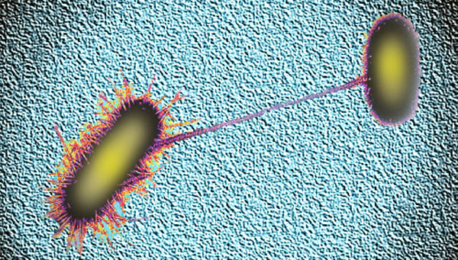
BAD BUGS!
Alfred DeMaria, Jr., M.D.
Massachusetts Department of Public Health

Slide 2
Presenter Disclosure Information
Alfred DeMaria, Jr., M.D.
Consultant | No relevant conflicts of interest to declare
Grant Research/Support | No relevant conflicts of interest to declare
Speaker’s Bureau | No relevant conflicts of interest to declare
Major Stockholder | No relevant conflicts of interest to declare
Other Financial or Material Interest | No relevant conflicts of interest to declare

Slide 3
“ESKAPE” Pathogens
Enterococcus faecium
Staphylococcus aureus
Klebsiella pneumoniae
Acinetobacter baumannii
Pseudomonas aeruginosa
Enterobacter species

Slide 4
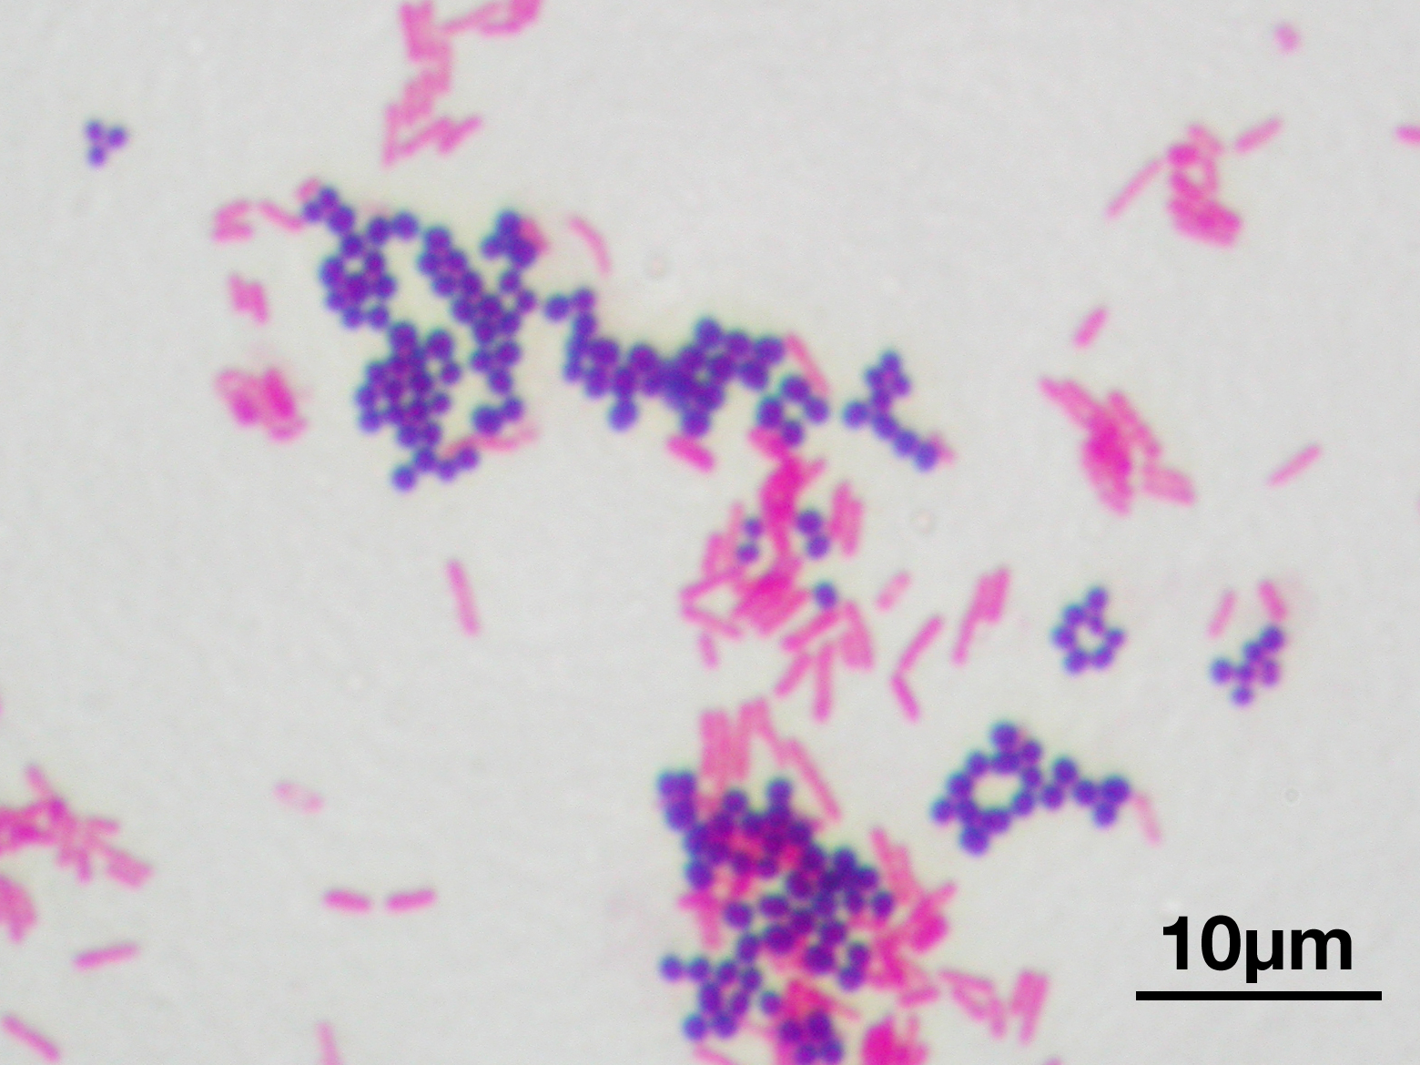

Slide 5
Gram-Negative Bacilli
In common parlance, rod-shaped bacteria that stain gram-negative
Two major groups based on where usually found
  Guts – Enterobacteriaceae – exposed to antibiotics used clinically or otherwise
    Escherichia coli (E. coli)
    Klebsiella species
    Proteus species
    Salmonella
    Other
  Environment – soil, “water bugs”- exposed to antibiotics in nature and used clinically and otherwise
    Pseudomonas aeruginosa
    Acinetobacter species
    Stenotrophomonas maltophilia

Slide 6
Antibiotic Resistance in Nature
Defense against antibiotics produced by fungi and other bacteria
Many mechanisms
Evolved through natural selection
Resistance genes spread among bacteria
Provides background of resistance mechanisms that can be further selected by use of antibiotics by humans

Slide 7
“… the greatest possibility of evil in self-medication is the use of too small doses so that instead of clearing up infection, the microbes are educated to resist penicillin and a host of penicillin-fast organisms is bred out which can be passed to other individuals and from them to others until they reach someone who gets a septicemia or a pneumonia which penicillin cannot save.”
- Sir Alexander Fleming, 1945

Slide 8
Bad Bugs
Difficult to treat, running out of drugs
Higher mortality
Resistance genes spread

Slide 9
Antimicrobials
The only medications that affect the patient being treated
and
other people, both at present
and in the future

Slide 10
What We Know
Increased antibiotic use, increased resistance
Longer treatment, increased colonization
Resistance more prevalent in healthcare facilities than community
Areas of higher antibiotic use have highest resistance
Antibiotic use correlates with outbreaks with resistant strains

Slide 11
Resistance Occurs Because:
Genetic variation in microorganisms results in some members of the population being less susceptible to agents than others
Presence of the antibiotic selects for resistant organisms already present

Slide 12
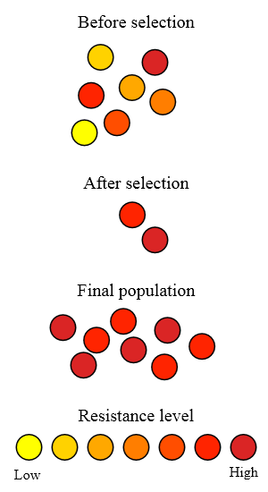

Slide 13
Patients Acquire Resistant Organisms:
By selection of resistant organisms through antibiotic exposure
From another colonized or infected individual
From the environment

Slide 14
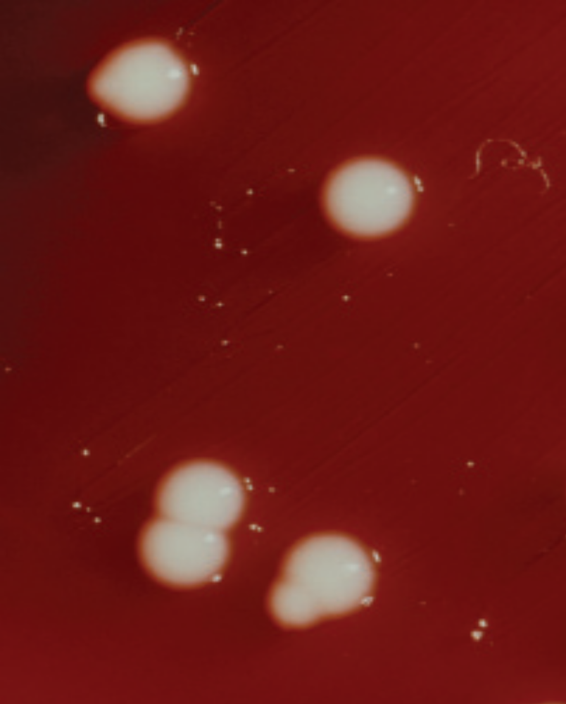

Slide 15
Extended Spectrum Beta-Lactamase (ESBL) Producing Organisms
25% K. pneumoniae in hospitalized patients in France, 1993-1996
12% K. pneumoniae in U.S. ICU
and 8% non-ICU patients (Fridkin 1997)
10% K. pneumoniae; 3% E. coli
resist to 3rd gen. ceph’s U.S. ICUs (NNIS, 1999)

Slide 16
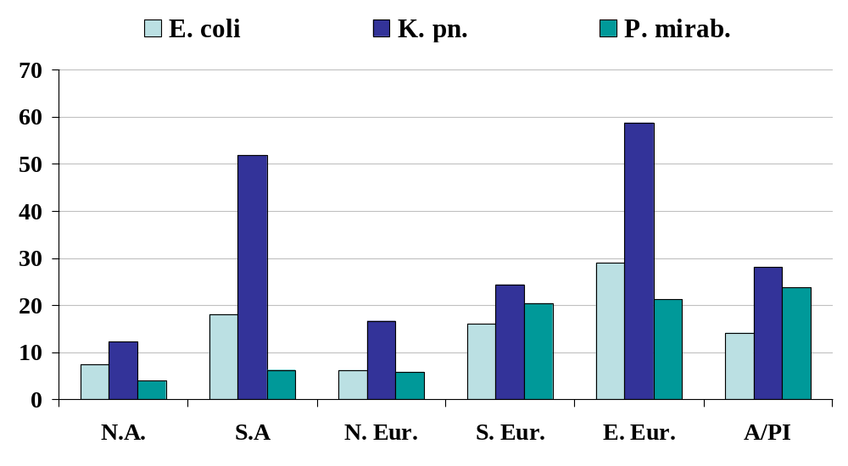
ESBL Phenotype
Meropenem Yearly Susceptibility Test Information Collection (MYSTIC) study, 1997-2003
Turner PJ. Clin ID 2005; 41 (S. 4): S273-75

Slide 17
ESBLs Impact
In most studies, no effect on mortality
Case-control study CAZ-R
Klebsiella/E. coli bacteremia:
↑mortality if appropriate therapy
not started in first 3 days (p=0.02)
(Schiappa, J Inf Dis 1996)

Slide 18
ESBLs and
Quinolone Resistance
56% of ESBL-producing E. coli and Klebsiella in 2 Philadelphia hospitals were also resistant to ciprofloxacin and/or levofloxacin
Quinolone resistance in ESBLs associated with prior quinolone use and residence in a LTCF
Lautenbach, CID 2001

Slide 19
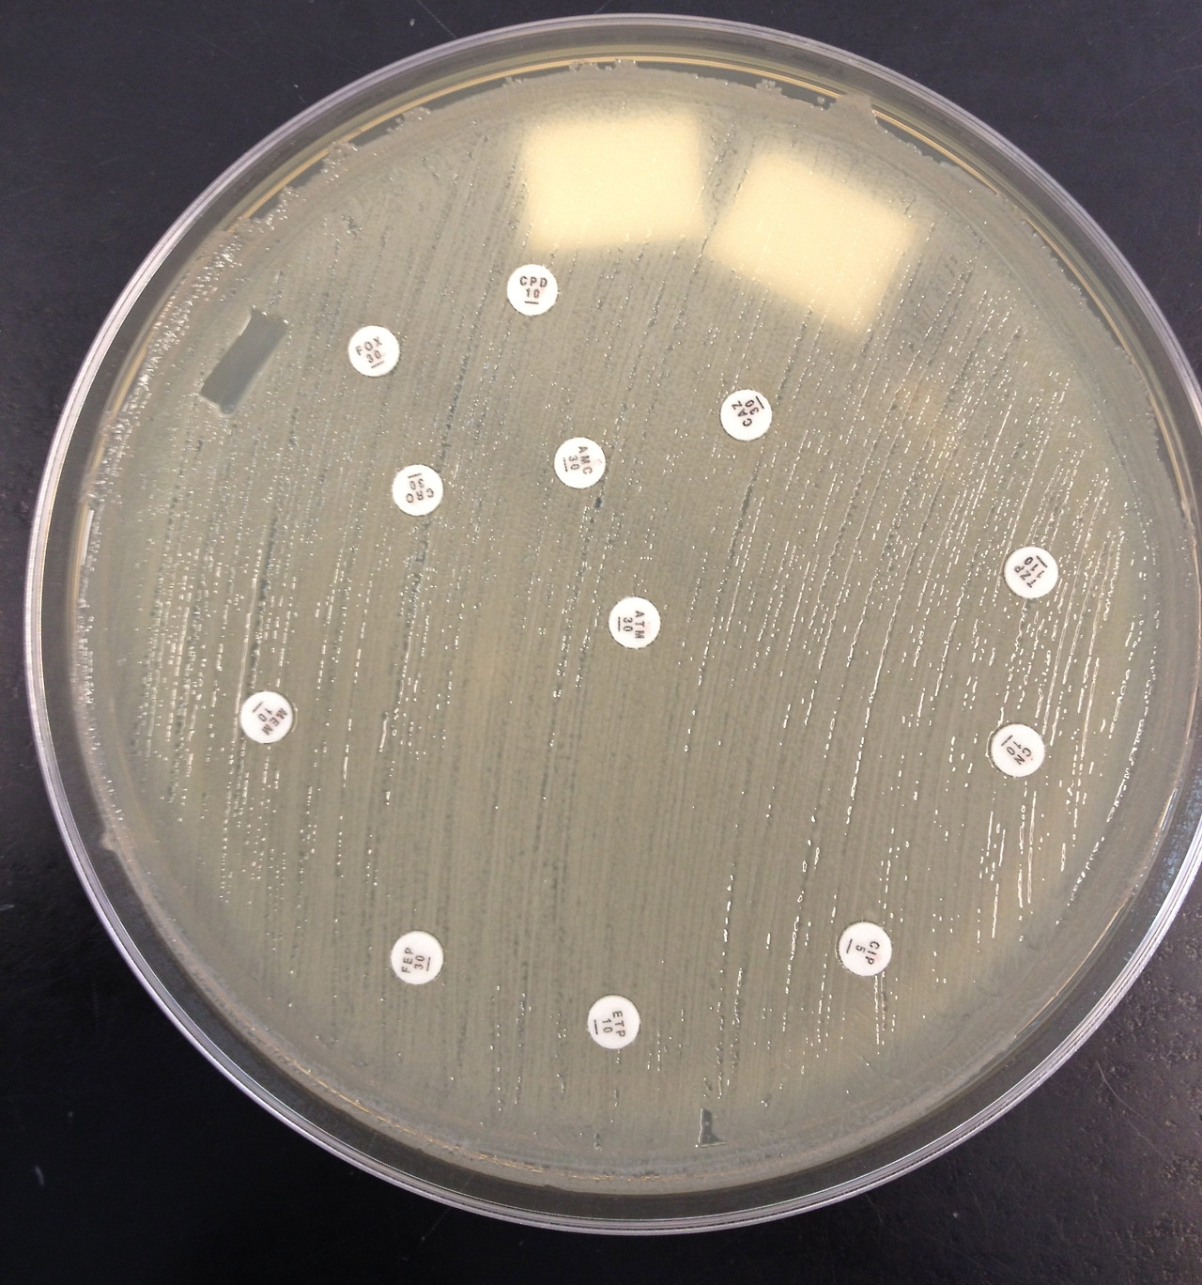

Slide 20
How are Carbapenems Used?
By Clinical Syndrome
Bacterial meningitis
Hospital-associated sinusitis
Sepsis of unknown origin
Hospital-associated pneumonia
By Clinical Isolate
Acinetobacter spp.
Pseudomonas aeruginosa
Alcaligenes spp.
Enterobacteriaceae
  Mogenella spp.
  Serratia spp.
  Enterobacter spp.
  Citrobacter spp.
  ESBL or AmpC + E. coli and Klebsiella spp.
Reference: Sanford Guide

Slide 21
Susceptibility Profile of
KPC-Producing K. pneumoniae
Antimicrobial | Interpretation |  | Antimicrobial | Interpretation
Amikacin | I |  | Chloramphenicol | R
Amox/clav | R |  | Ciprofloxacin | R
Ampicillin | R |  | Ertapenem | R
Aztreonam | R |  | Gentamicin | R
Cefazolin | R |  | Imipenem | R
Cefpodoxime | R |  | Meropenem | R
Cefotaxime | R |  | Pipercillin/Tazo | R
Cetotetan | R |  | Tobramycin | R
Cefoxitin | R |  | Trimeth/Sulfa | R
Ceftazidime | R |  | Polymyxin B | MIC >4μg/ml
Ceftriaxone | R |  | Colistin | MIC >4μg/ml
Cefepime | R |  | Tigecycline | S

Slide 22
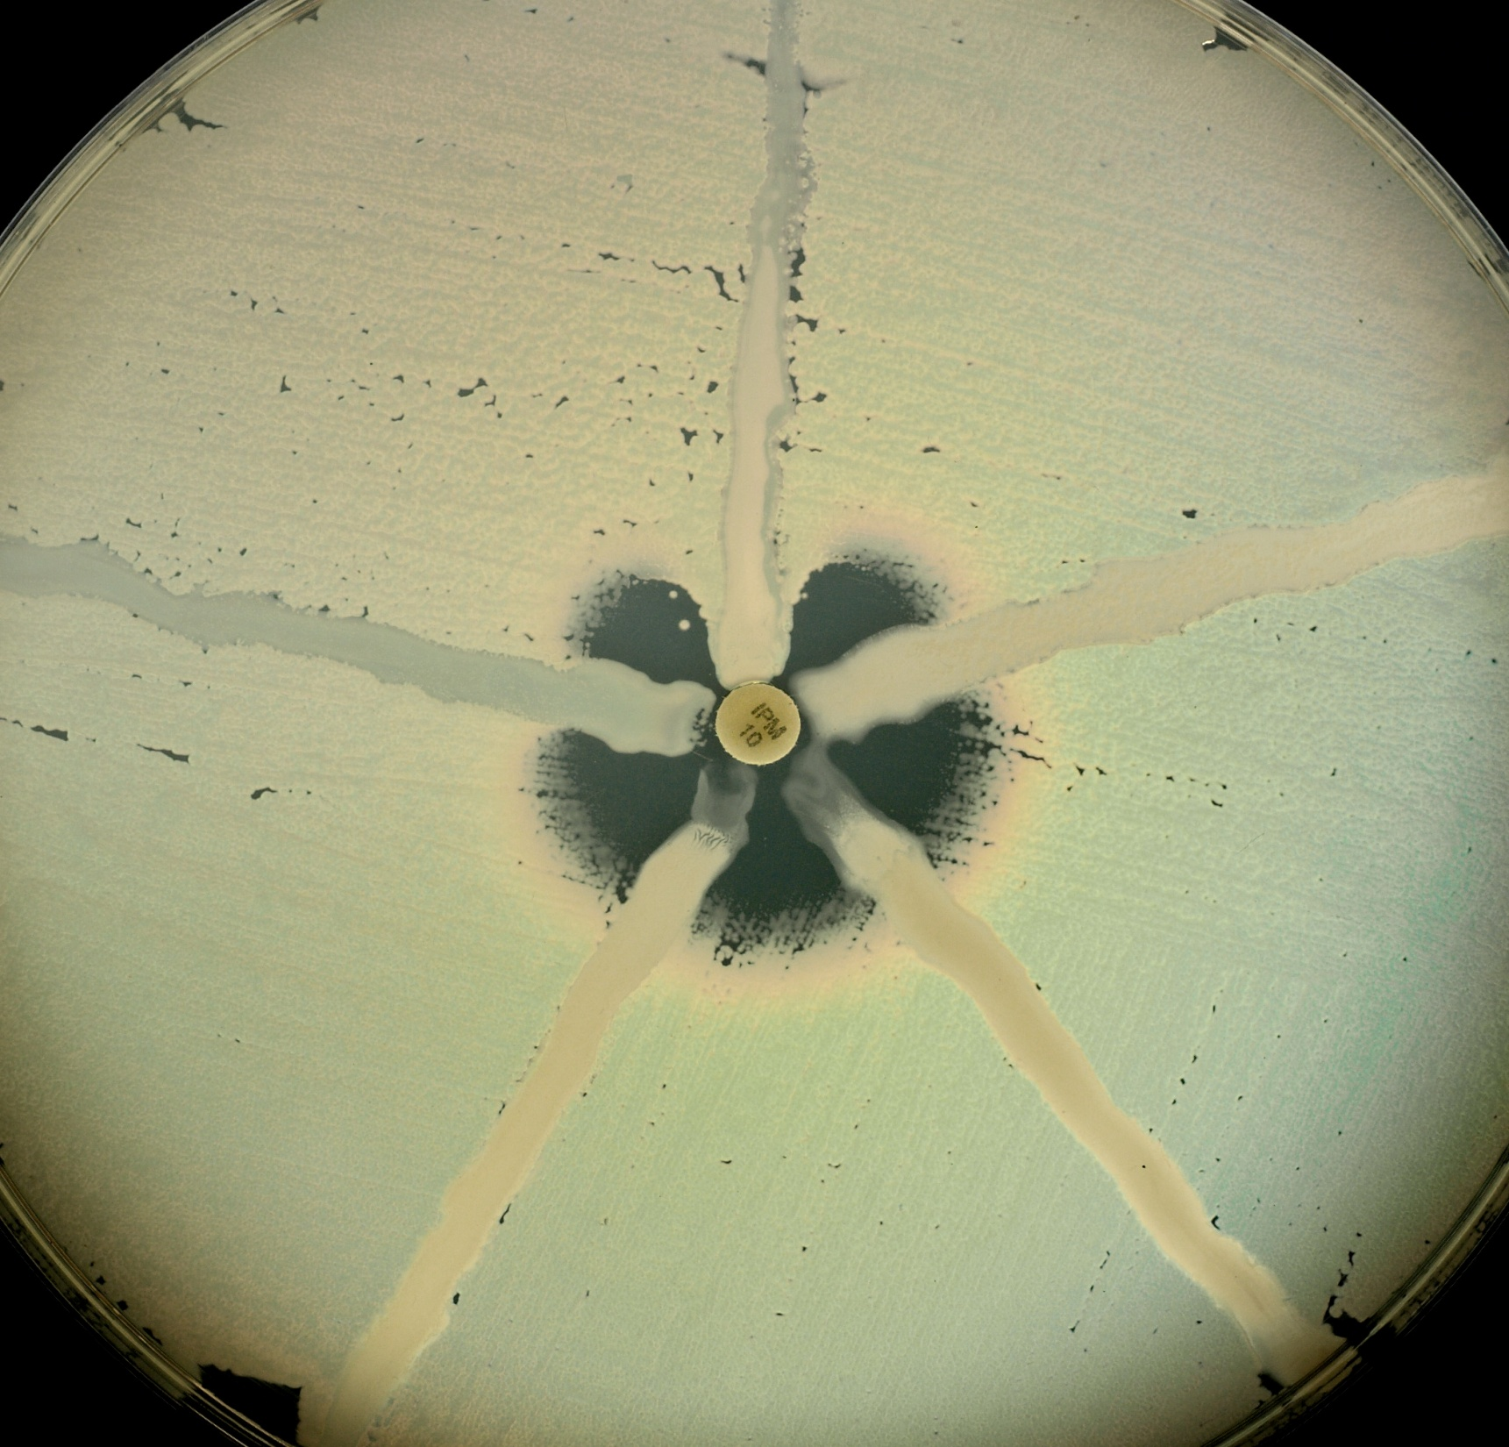

Slide 23
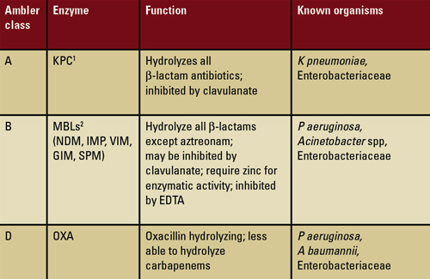

Slide 24
Metallo-β-Lactamase
Hydrolize virtually all β-lactams, including carbapenems (imipenem, ertapenem, meropenem, etc.)
Multiple types (IMP 1-16, VIM 1-7, SPM, GIM, OXA-23) – increasing diversity
Pseudomonas aeruginosa, Acinetobacter sp., Serratia marcescens, Klebsiella pneumoniae

Slide 25
Acinetobacter baumannii
Long associated with hospital outbreaks, esp. related to water sources and product contamination, ICUs
Emerging problem in Asia (2004 Tsunami), Middle East (Iraq) snd tropics, in general
Resistant to virtually all drugs tested
  Some susceptibility to carbapenems
  Susceptible to polymixins
Wound infection, pneumonia, UTI
Surveillance cultures of groin, axillae and wounds

Slide 26
CRE Infection Outcomes
CRE versus susceptible K. pneumoniae (NYC, Patel, et al. 2008)
  Mortality: 48% versus 20%
  Infection mortality: 38% versus 12%
  Removal/debridement associated with survival
  Timely treatment with in vitro active agent not associated with survival
CRE KPC versus non-bacteremic (Israel, Borer, et al. 2009)
  Mortality: 72% versus 22%
  Attributable mortality 50%

Slide 27
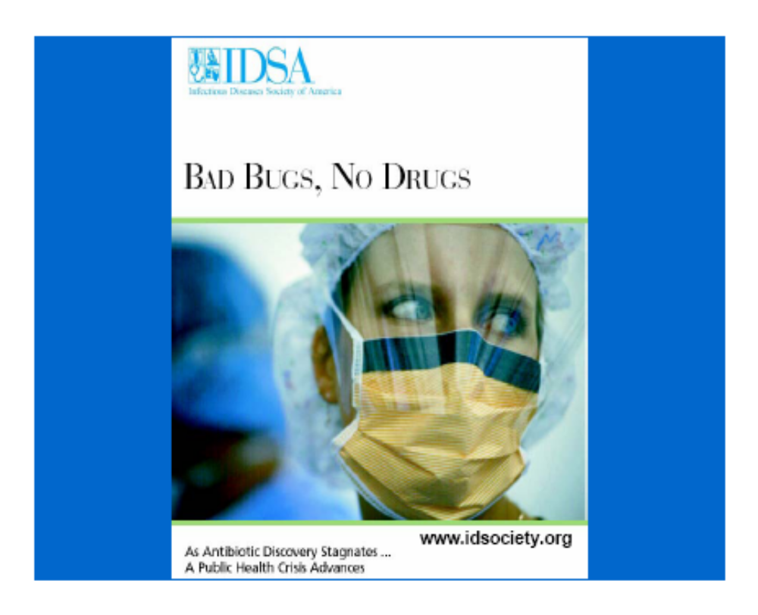

Slide 28
Antibiotics Available, and the Ones That Worked Against Resistance Gram-Negative Bacilli in Each Time Period
1940-50s
Sulfonamides
Penicillins
Streptomycin
Tetracyclines
Chloramphenicol
Colistins
1960-70s
Penicillins
Streptomycin
Tetracyclines
Chloramphenicol
Colistins
Fosfomycin
1st Gen. Chephalosporins
Gentamicin
1980-90s
Penicillins
Streptomycin
Tetracyclines
Chloramphenicol
1st Gen. Chephalosporins
Gentamicin
Colistins
Fosfomycin
Tobramycin
Amikacin
2nd Gen. Cephalosporins
3rd Gen. Cephalosporins
Ext. Spectrum Penicillins
Beta-lactamase Inhibitors
Carbapenems
1990-2000s
Penicillins
Streptomycin
Tetracyclines
Chloramphenicol
1st Gen. Chephalosporins
Gentamicin
Colistins
Fosfomycin
Tobramycin
Amikacin
2nd Gen. Cephalosporins
3rd Gen. Cephalosporins
Ext. Spectrum Penicillins
Beta-lactamase Inhibitors
Carbapenems
Tigecycline
2013
Penicillins
Streptomycin
Tetracyclines
Chloramphenicol
1st Gen. Chephalosporins
Gentamicin
Colistins
Fosfomycin
Tobramycin
Amikacin
2nd Gen. Cephalosporins
3rd Gen. Cephalosporins
Ext. Spectrum Penicillins
Beta-lactamase Inhibitors
Carbapenems
Tigecycline

Slide 29
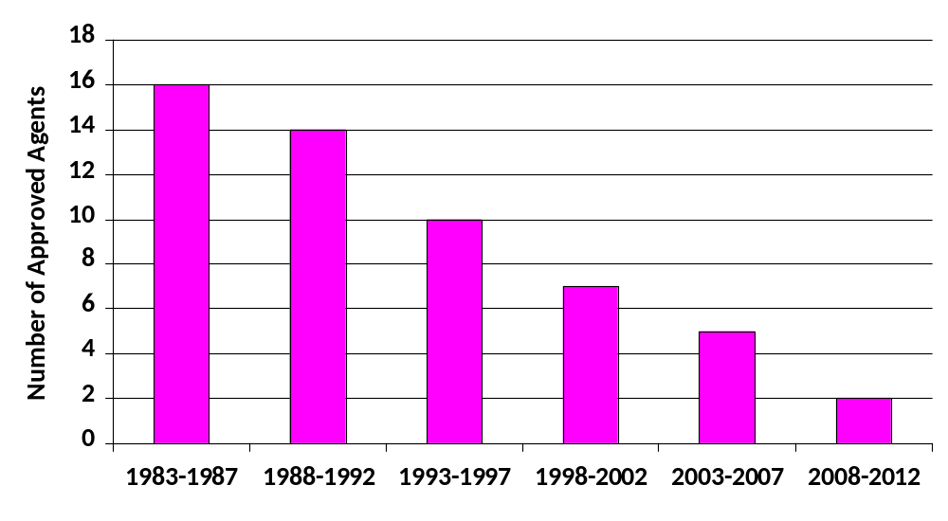
FDA-Approved New Antimicrobials
(Modified from Boucher, et al 2013; Spellberg 2004)

Slide 30
Considerations in Antibiotic Selection
Susceptibility of infecting organism
Effectiveness of agent for particular infection
Narrow spectrum of activity
Safety
Cost
= most effective, safest, cheapest, active agent, with the narrowest spectrum of activity

Slide 31
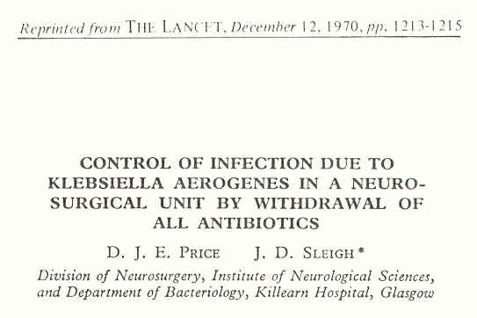
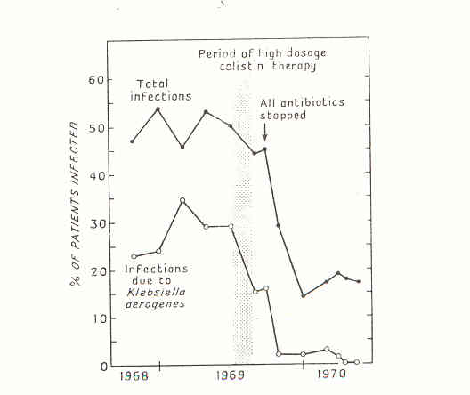

Slide 32
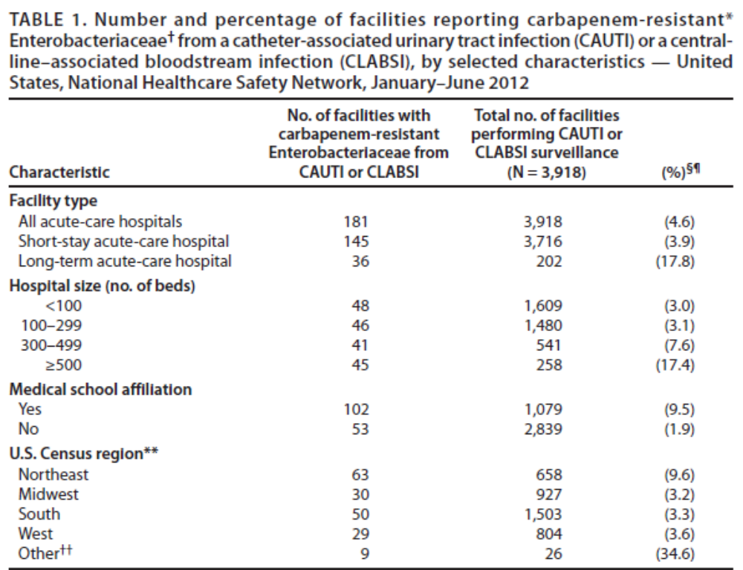

Slide 33
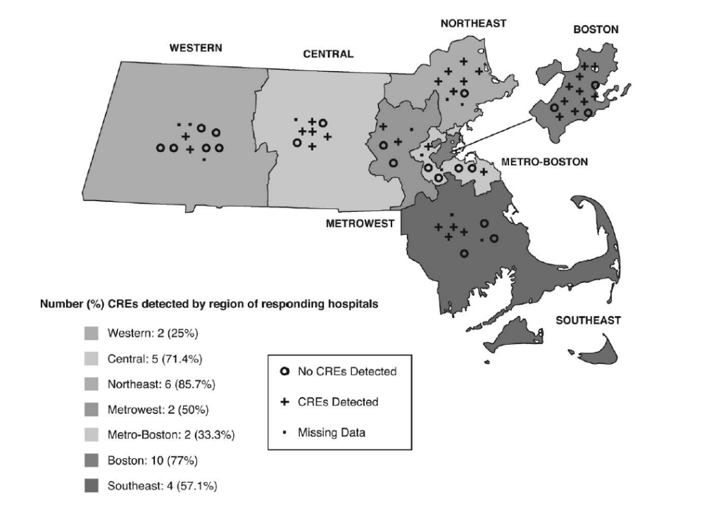
Thibodeau E, et al. Infection Control and Hospital Epidemiology 2012; 33: 954-956

Slide 34
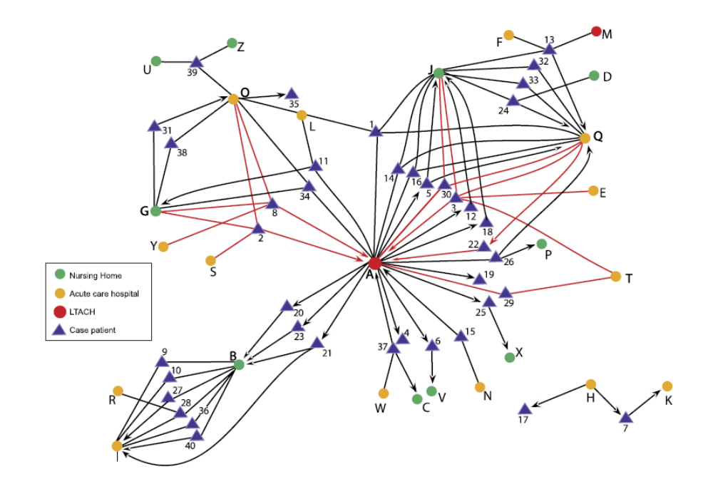
Exposure Network Graph Demonstrating the Relationships of Cases with KPC to Long-term Acute Care Hospitals (Ltachs), Acute Care Hospitals, and Nursing Homes in the Chicago Area
Won SY, Clin Infect Dis. 2011; 53 :532-40.

Slide 35
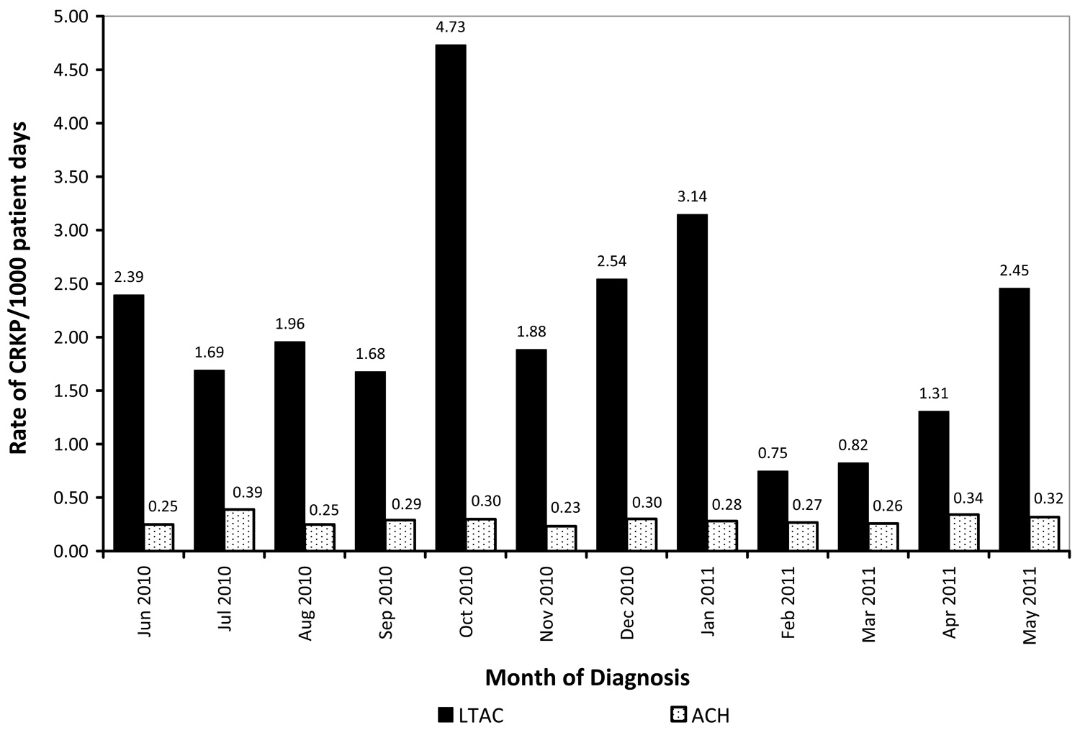
Monthly carbapenem-resistant Klebsiella pneumoniae (CRKP) pooled mean rate of infection in Los Angeles County
Marquez, et al. Infect Control Hosp Epidemiol. 2013 ; 34:144-50

Slide 36
Core Measures for All Acute and
Long-term Care Facilities (CDC)
1. Hand hygiene
  Promote hand hygiene
  Monitor hand hygiene adherence and provide feedback
  Ensure access to hand hygiene stations
2. Contact Precautions
  Acute care
    Place CRE colonized or infected patients on Contact Precautions (CP)
      Preemptive CP might be used for patients transferred from high-risk settings
    Educate healthcare personnel about CP
    Monitor CP adherence and provide feedback
    No recommendation can be made for discontinuation of CP
    Develop lab protocols for notifying clinicians and IP about potential CRE
  Long-term care
    Place CRE colonized or infected residents that are high-risk for transmission on CP)
    Patients at lower risk for transmission use Standard Precautions for most situations.

Slide 37
Core Measures for All Acute and
Long-term Care Facilities (CDC)
3. Patient and staff cohorting
  When available cohort CRE colonized or infected patients and the staff that care for them evenif patients are housed in single rooms
  If the number of single patient rooms is limited, reserve these rooms for patients with highest risk for transmission (e.g., incontinence)
4. Minimize use of invasive devices
5. Promote antimicrobial stewardship
6. Screening
  Screen patient with epidemiologic links to unrecognized CRE colonized or infected patients and/or conduct point prevalence surveys of units containing unrecognized CRE patients

Slide 38
Supplemental Measures for Healthcare Facilities with CRE Transmission (CDC)
Active surveillance testing
  Screen high-risk patients at admission or at admission and periodically during their facility stay for CRE. Preemptive CP can be used while results of admission surveillance testing are pending
  Consider screening patients transferred from facilities known to have CRE at admission
Chlorhexidine baths
  Bathe patients with 2% chlorhexidine

Slide 39
